Slide 1

Medical
SAWbots
Saving Lives by Revolutionizing Surgical Technology
Notes:
Speech resources:
Nanoparticles and targeted drug delivery in cancer therapy - https://www.ncbi.nlm.nih.gov/pubmed/28760499
Understanding targeted therapy - https://www.cancer.net/navigating-cancer-care/how-cancer-treated/personalized-and-targeted-therapies/understanding-targeted-therapy

Slide 2
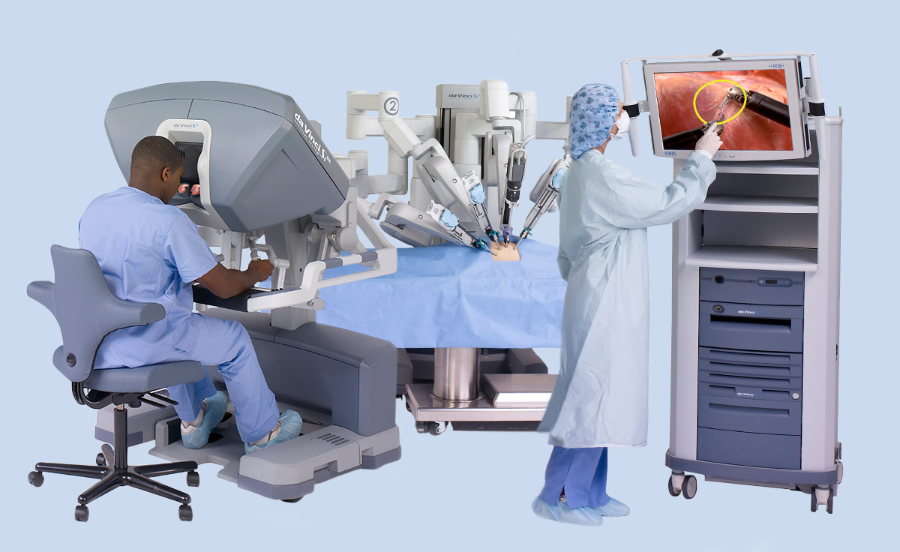
Limited Accessibility to Life Saving MIP Tools
Minimally Invasive Procedure (MIP) medical technology:
Procedures using tiny surgical instruments
Existing MIP machines are expensive and bulky
Da Vinci Surgical Machine
Average installed cost is $2 million
Notes:
The problem our team is trying to tackle is the current lack of MIP, or minimally invasive procedure technology
Minimally invasive procedures are surgical techniques that use small incisions that act as ports for tiny, rontrolled surgical instruments to operate
This is contrast with conventional surgical techniques which requires large incisions large enough for sugeons to reach their hands and macroscopic tools into
For example, a conventional open heart surgery
In the figure shown is a Da Vinci surgical robot, currently the most common MIP tool. It’s average cost of installation is $2M, a price point out of reach for most hospitals
Robotic devices at the millimeter and micron scale have significant potential to revolutionize biomedicine.
Localized delivery has the potential for minimized side effects, reduced intake frequency, and enhanced patient compliance with minimized in vivo instability of drug formulations, and constancy in drug concentrations within a therapeutic range [
Current cancer treatments are non-discriminant
Current microsurgery is limited by physical tool size a can physician control
How big
Cost
Use cases - Microsurgeries: eyes, nerves, blood vessels

Slide 3


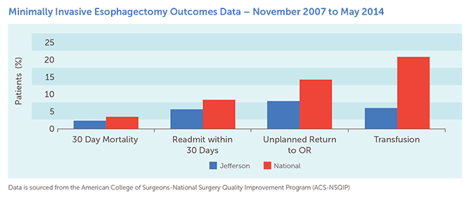
MIP Improves Patient Outcomes
Conventional surgery is associated with inferior results
Decreased risk of infection
Improved recovery time
Shorter hospital stays
Graph depicting patient outcomes for MIP vs. non-MIP procedures
Source: University HealthSystem Clinical Database
Notes:
The reason why this current
The superiority of robotic surgery has been constantly shown in literature, and we can visually see in the graph that
Because MIP technology is not universally available, patients are not getting the best treatment available
Find better graphic

Slide 4
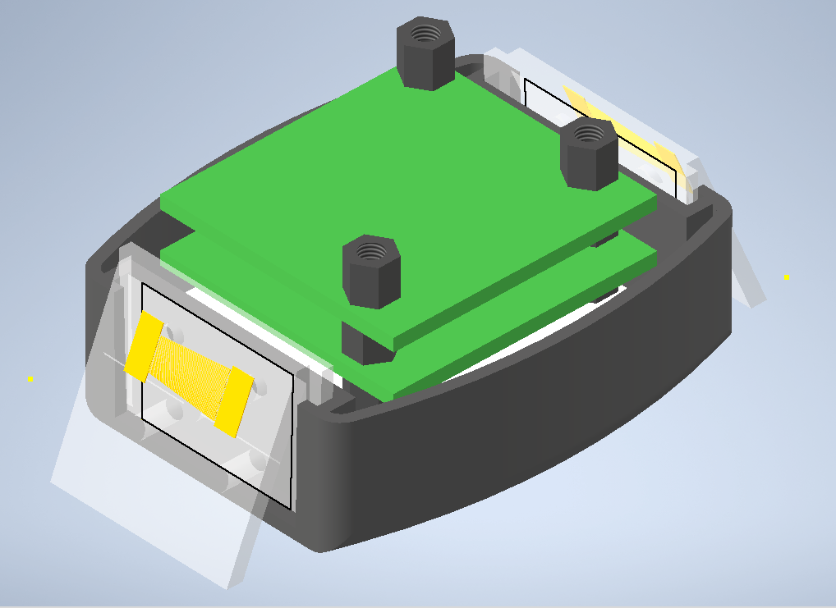
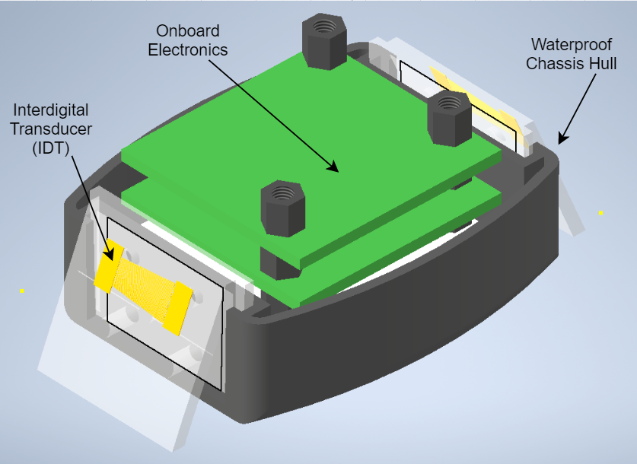
Our Solution: SAWbots
Propulsion: Safe for use en vivo
Wireless: No external wires or battery
Affordable: Cost of materials is $200
Modular: Multiple PCBs and IDT
mounting blocks
3D Assembly Model of SAWbot
Notes:
I really wanna put this slide at the end of the rest of my slides. The transition from Phil’s into my section can involve the SAW device labeled in figure 4. Then I can transition into Alex’s (or whoever does it) slide using the PCBs which are unnecessary to bring up beforehand. I believe this will flow better. Of course the block diagram could potentially change things.
One of the significant improvements made to Bourquin and Cooper’s design was the elimination of wire connections off the bot. This is critical for a surgical application because it frees the bot from unpredictable tension forces and tangling caused by external wires. The movement is therefore made more precise with the tradeoff of requiring electrical components onboard the bot to power and control it. The design is four orders of magnitude cheaper than the Da Vinci machine costing only $200 of materials to produce Modularity is achieved by separating the PCBs into three distinct boards so each can be tested and revisioned individually, then secured to the chassis using nylon standoffs. Furthermore, our Interdigitated Transducers, the devices responsible for propulsion, are mounted on removable blocks that can be easily interchanged.
Can assume power and thrust are necessary
Label more things, try squeezing down the image
Spell out idt (literally and then also spell it out by expanding the theory on its own slide whoever wrote this is a genius)
Add block diagram after

Slide 5
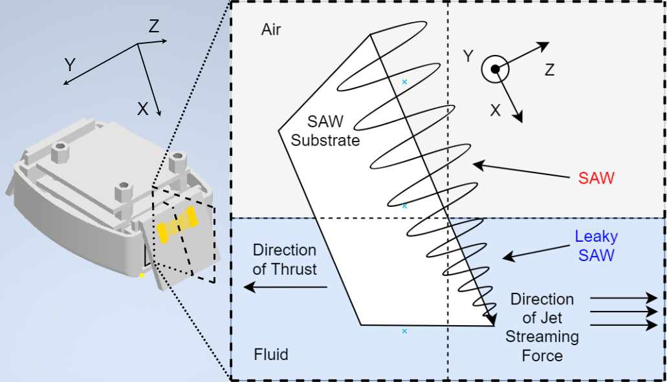
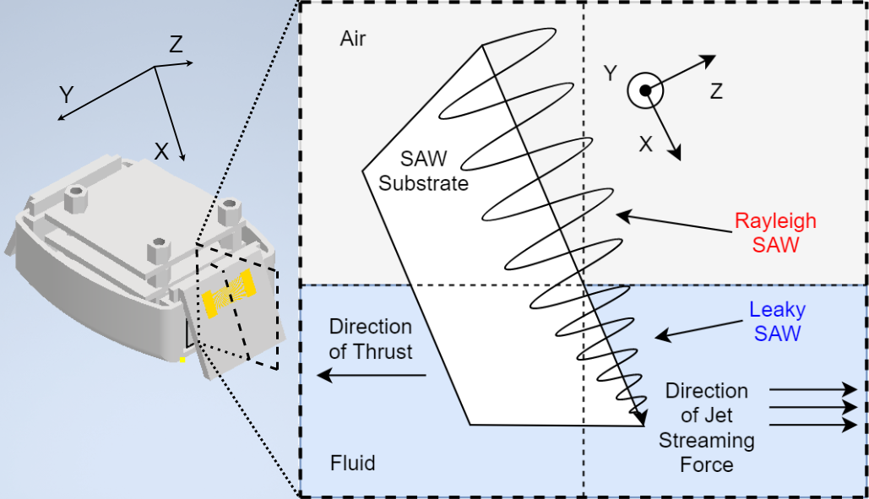
Theory of SAW Propulsion
When a SAW enters a fluid, it Leaks energy into the fluid
Notes:
When the SAW enters a liquid, the SAW’s energy is absorbed into the fluid, generating a jet stream which pushes the SAWbot forward. SAW Streaming provides many advantages over conventional propulsion systems such as combustion thrusters which release harmful chemical byproducts or rotary propellers which could lacerate tissue during surgery.
Tela wants more in depth explanation of SAW generation in the IDT
Reduce clutter, size figure on right larger because it is more important

Slide 6
Simulation Verifies Leaky SAW Behavior
Peak Amplitude: 1 nm
Z
X
Y
3D MATLAB Animated Line Plot of Leaky SAW Propagation
Notes:
Through simulation, we confirmed that thrust force great enough to propel the bot can be achieved by using a SAW with a peak amplitude of only 1 nm that is far too small to damage surrounding tissues during surgery.
Gif does not work in Zoom
Label axes and direction of propagation
Improve title to reflect verification, highlight 1nm and that it is verifying the research paper

Slide 7
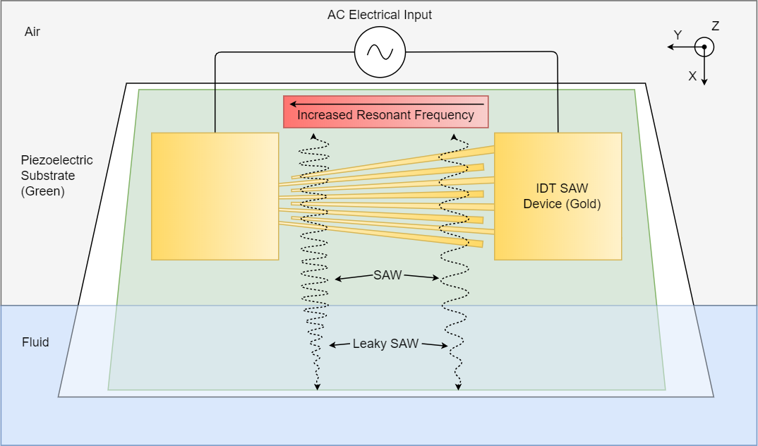
Interdigital Transducer (IDT) - SAW Motor
IDTs consist of a pair of interlocked electrodes atop a piezoelectric substrate that convert AC electrical power into SAW power
Notes:
The motor of our SAWbot is an Interdigital Transducer, which converts electrical power into wave power. The electrode fingers must be carefully designed to match the frequency of the electrical input. By varying the width of the fingers across their length, the location of SAW generation can be controlled, allowing us to

Slide 8
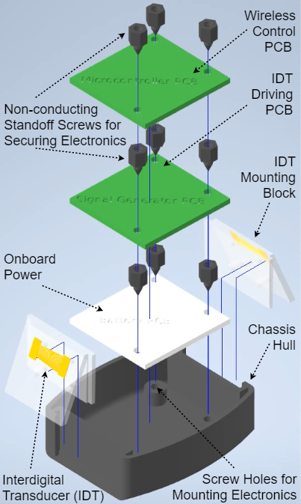
System Overview of SAWbot
Wireless Control Board
Wireless Power Board
IDT Driving Board
Expanded 3D Assembly Model SAWbot Components featuring the PCB Stackup and IDTs mounted to the Chassis

Slide 9
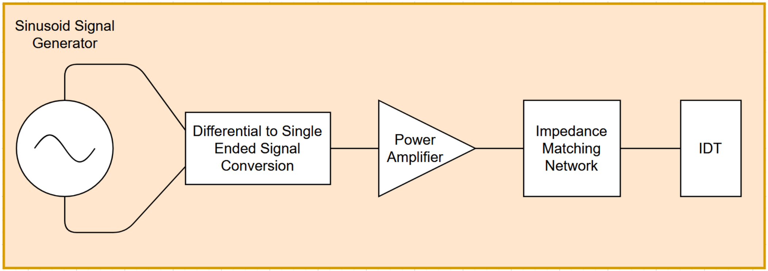
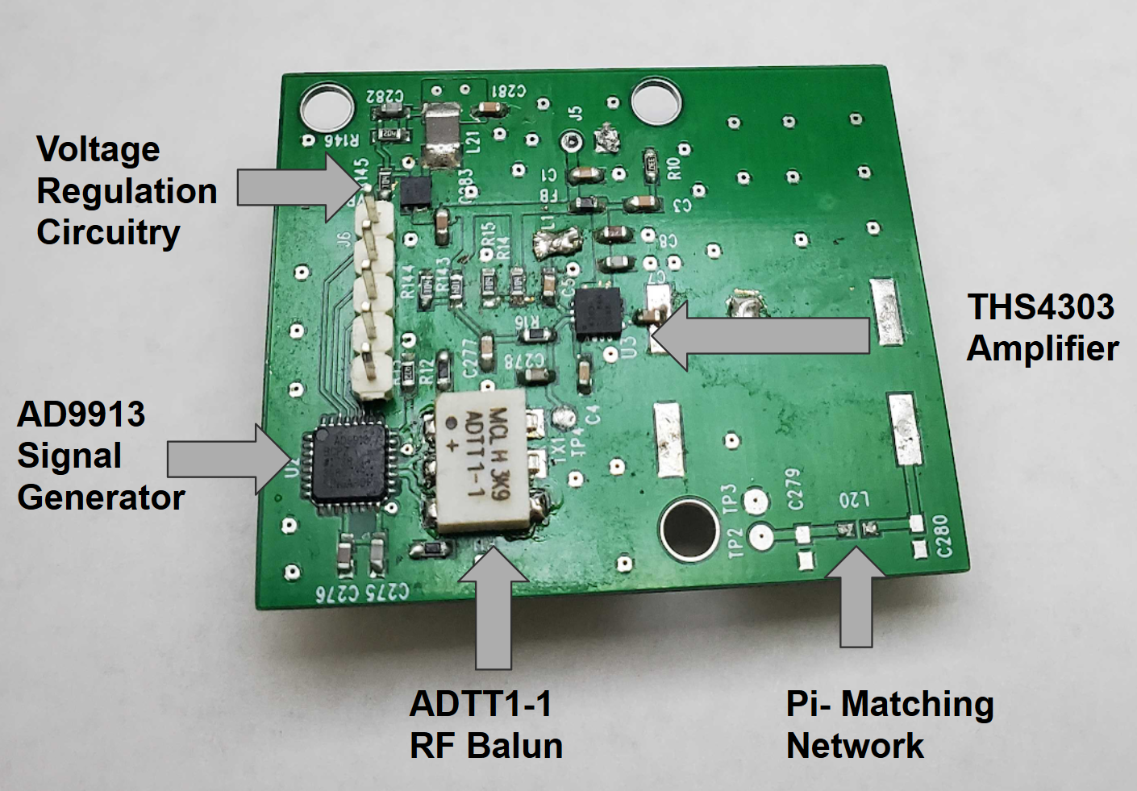
Accomplishing Onboard Signal Generation
Resulting in 1mN of Thrust
IDT Propulsion Module Block Diagram
Propulsion Board Top Layer View
Notes:
The propulsion board uses the AD9913 Direct Digital Synethizer chip to generate a high frequency sinusoidal signal on board the bot. This signal will be fed to the IDT which converts electrical energy to mechanical energy and produces Surface acoustic waves. The THS4303 amplifies the electrical power before delivery to the IDT, thereby resulting in 1mN of thrust force

Slide 10
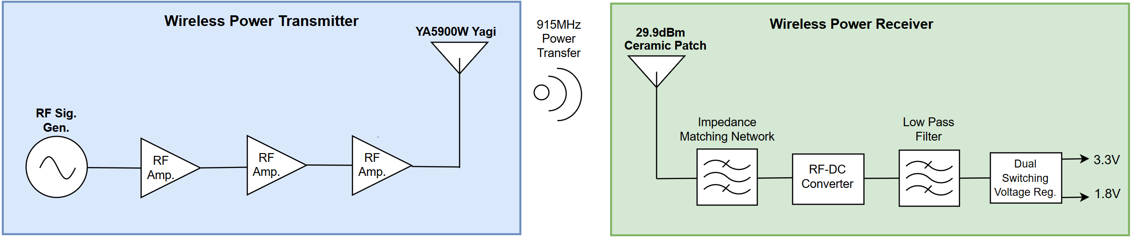
RF Wireless Power Simulation Verified
Simulation exceeds power requirements
Verified using AWR RF Simulation
Stays within FCC Regulations
Notes:
In the process of designing our project we ran into the problem of limited mobility with conventional power resources. Conventual resources being wired power and other battery powered devices. Our solution to this problem while still keeping to the objective of increased mobility would be the implementation of RF wireless power. Using RF Wireless power at a distance of 6cm we can both complete our objective and overcompensate for the power needs of our device by 100mW.

Slide 11

SAWbots will Revolutionize Medicine
Project Achievements
Simulated Wireless Power
Simulated SAW Propulsion
Physical Assembly of Bot
Platform for novel form of treatments
Reduced healthcare cost
Notes:
SAWbots can be used for many medical applications. This device is a platform for novel methods of treatment. In the US alone, healthcare is a 2.2 trillion dollar industry. There are over 22 million surgeries a year. This device can aid in many of these surgical applications such as heart value repair and targeted drug therapy. This device is also affordable compared to other noninvase medical tools. 66.5% of bankruptcies are tied to medical issues alone and this tool will cost only 200 dollars compared to the 2 million dollar devnci tool. Medical treatment is a human right and should be given to everyone. SAWbots can help us do that.
Annually, there are over 22 million surgeries and 1.7 million new incidents of cancer per year
Advanced use cases
66.5% of bankruptcies are tied to medical issues
In the US alone, healthcare is a 2.2 trillion dollar industry
Annually, there are over 22 million surgeries and 1.7 million new incidents of cancer per year
Include final results/conclusion of simulations with quantified results
Talk about how our project enables microbots

Slide 12


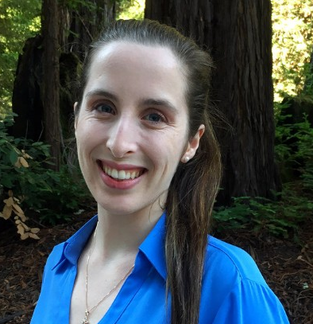

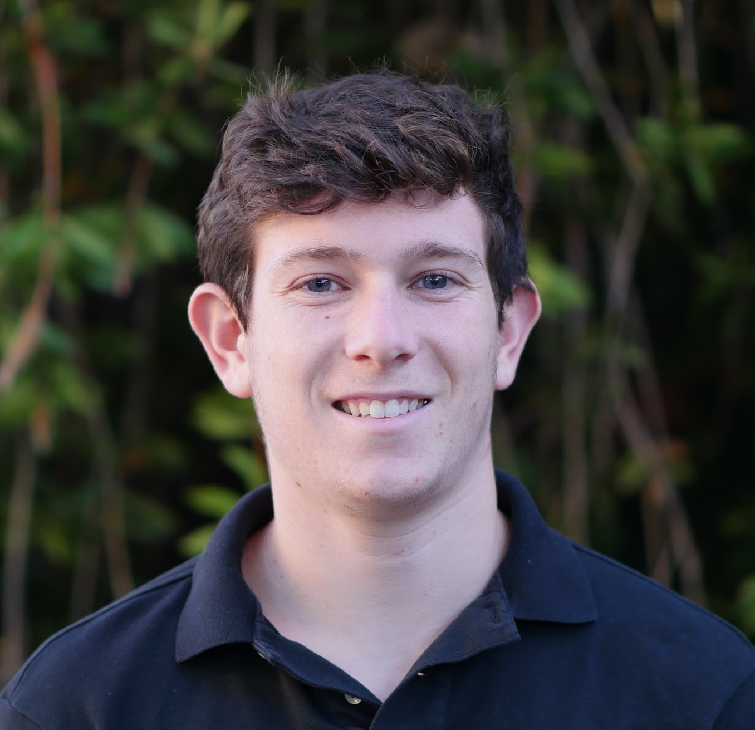

UCSC NANOENGINEERING GROUP
Dr. Yanik
Summer
Allie
Phil
Alex
Nic
Notes:
Our team was one of the only ones to not mention individual members’ skills
Our team works under Dr. Ali Yanik for his UCSC NanoEngineering Group. We are a uniquely qualified to produce this design, having a variety of skills that made this project become a reality
Due to our team members’ individual areas of expertise, our team is uniquely qualified to create the best possible solution to the lack of MIP technology
Summer Alherz - Power Systems Expert
Allie Hunsinger - Organizational Mastermind
Phil Canete - Integration Design Genius
Alex Bakaleynik - PCB Wizard
Nic Van Oss - SAW Physics Specialist
Add yanik group to titile, add bsoe logo, add nanoe logo

Slide 13
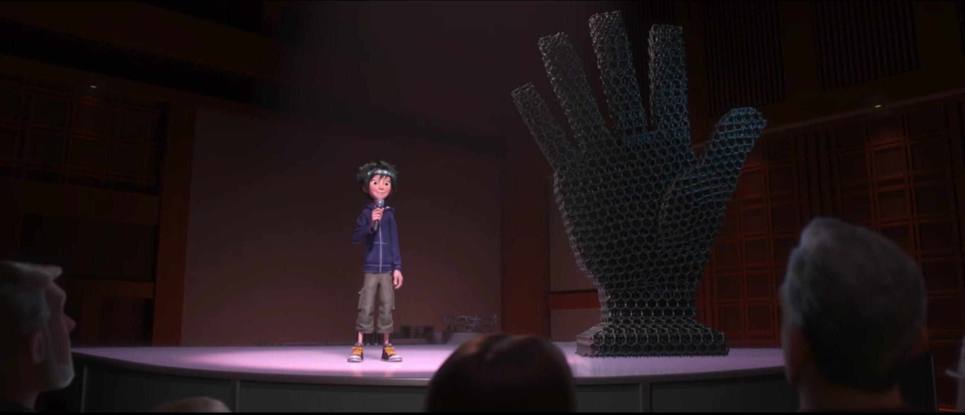
SAWbots!
Q&A

